Slide 1

NETWORK design
Cheese! PRIVATE Ltd
SAI TEJA BATHULA

Slide 2
Tech Requirements
Cloud Account
Laptop
Network Components

Slide 3
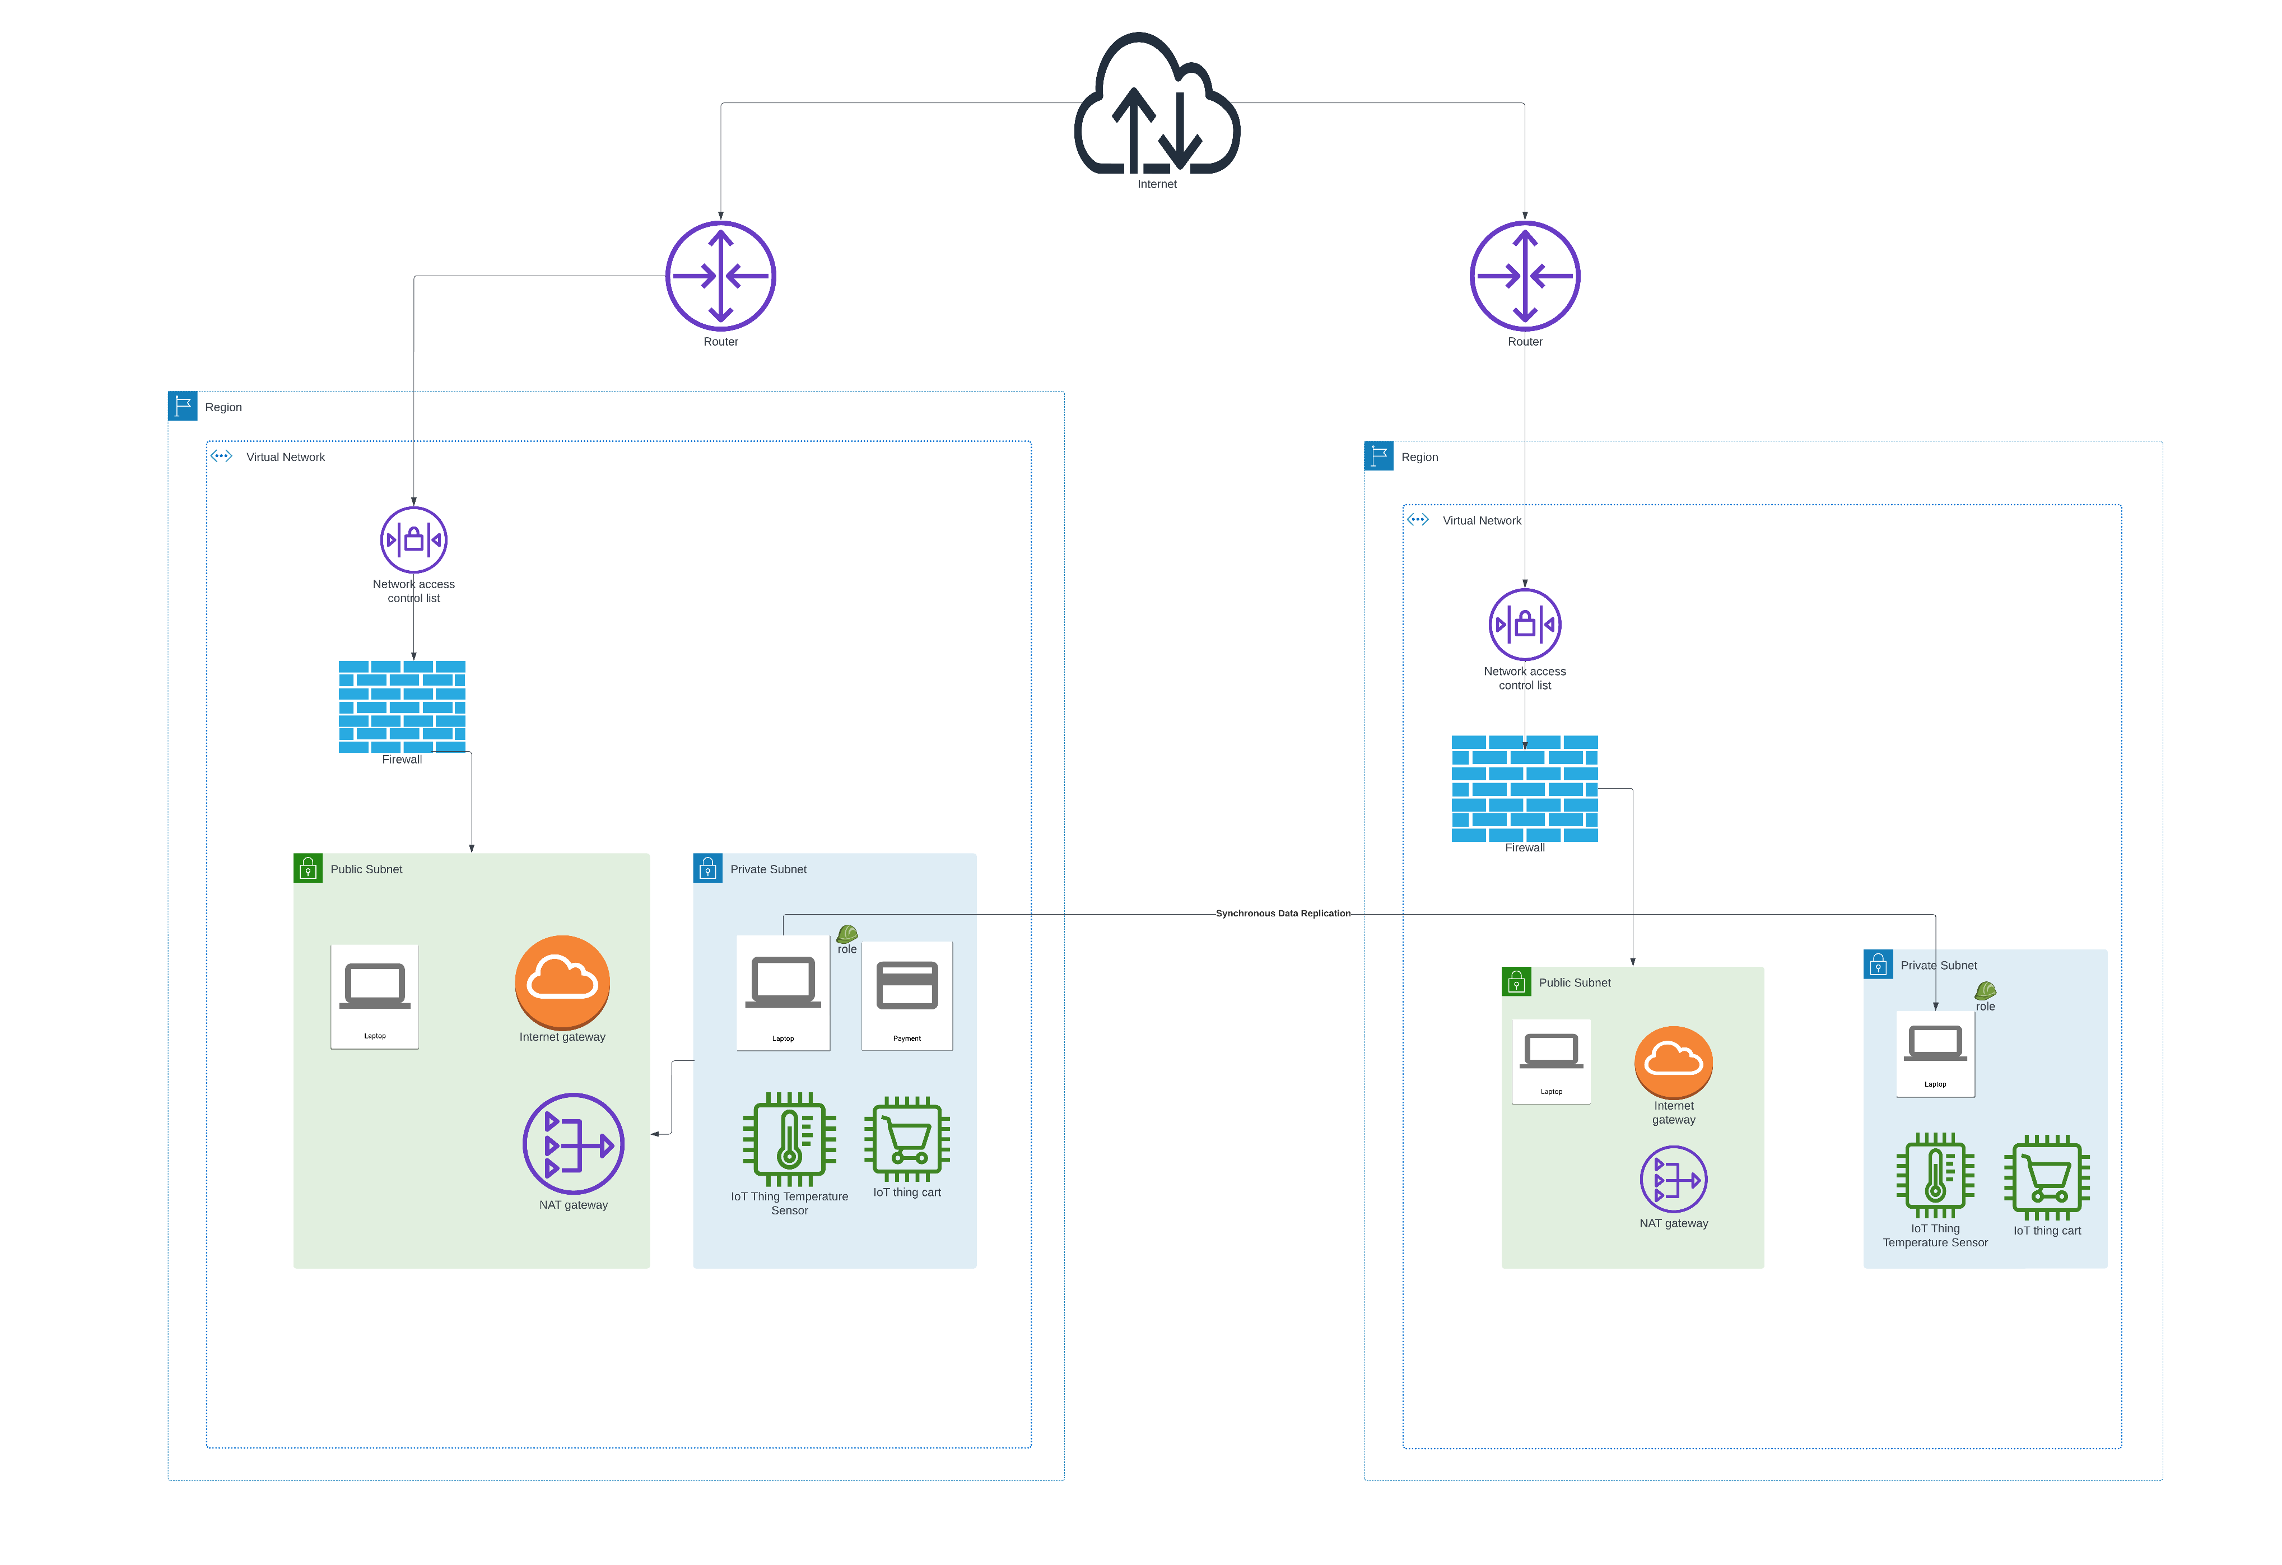
network architecture for Cheese! Pty Ltd

Slide 4
Deploying of webservers in cloud

Slide 5
The Proposed Architecture's Significance
A web server, database server, switches, routers, firewalls, and cloud storage are all part of the suggested network. A web server manages online orders, switches guarantee effective communication, routers and firewalls guard the network against external threats, and cloud storage provides a safe, scalable option.
In summary, this architecture guarantees a safe and effective network, protecting your information and fostering the expansion of your company.

Slide 6


Thank You
SAI TEJA BATHULA

